Slide 1
Lecture 4: Probability
USC VSoE CSCI 544: Applied Natural Language Processing
Jonathan May -- 梅約納
September 1, 2017
based on Kevin Knight's notes

Slide 2
Definitions
Experiment: Some action that takes place in the world
Outcomes = Sample Space = Ω = the universe; every basic outcome that could happen
Event = A ⊆Ω = something that happened (could be more than one basic outcome)
Probability Distribution: 𝓕: Ω→[0,1], ∑_{x ∈Ω} 𝓕(x)=1 i.e. the values sum to 1 and no value is negative

Slide 3
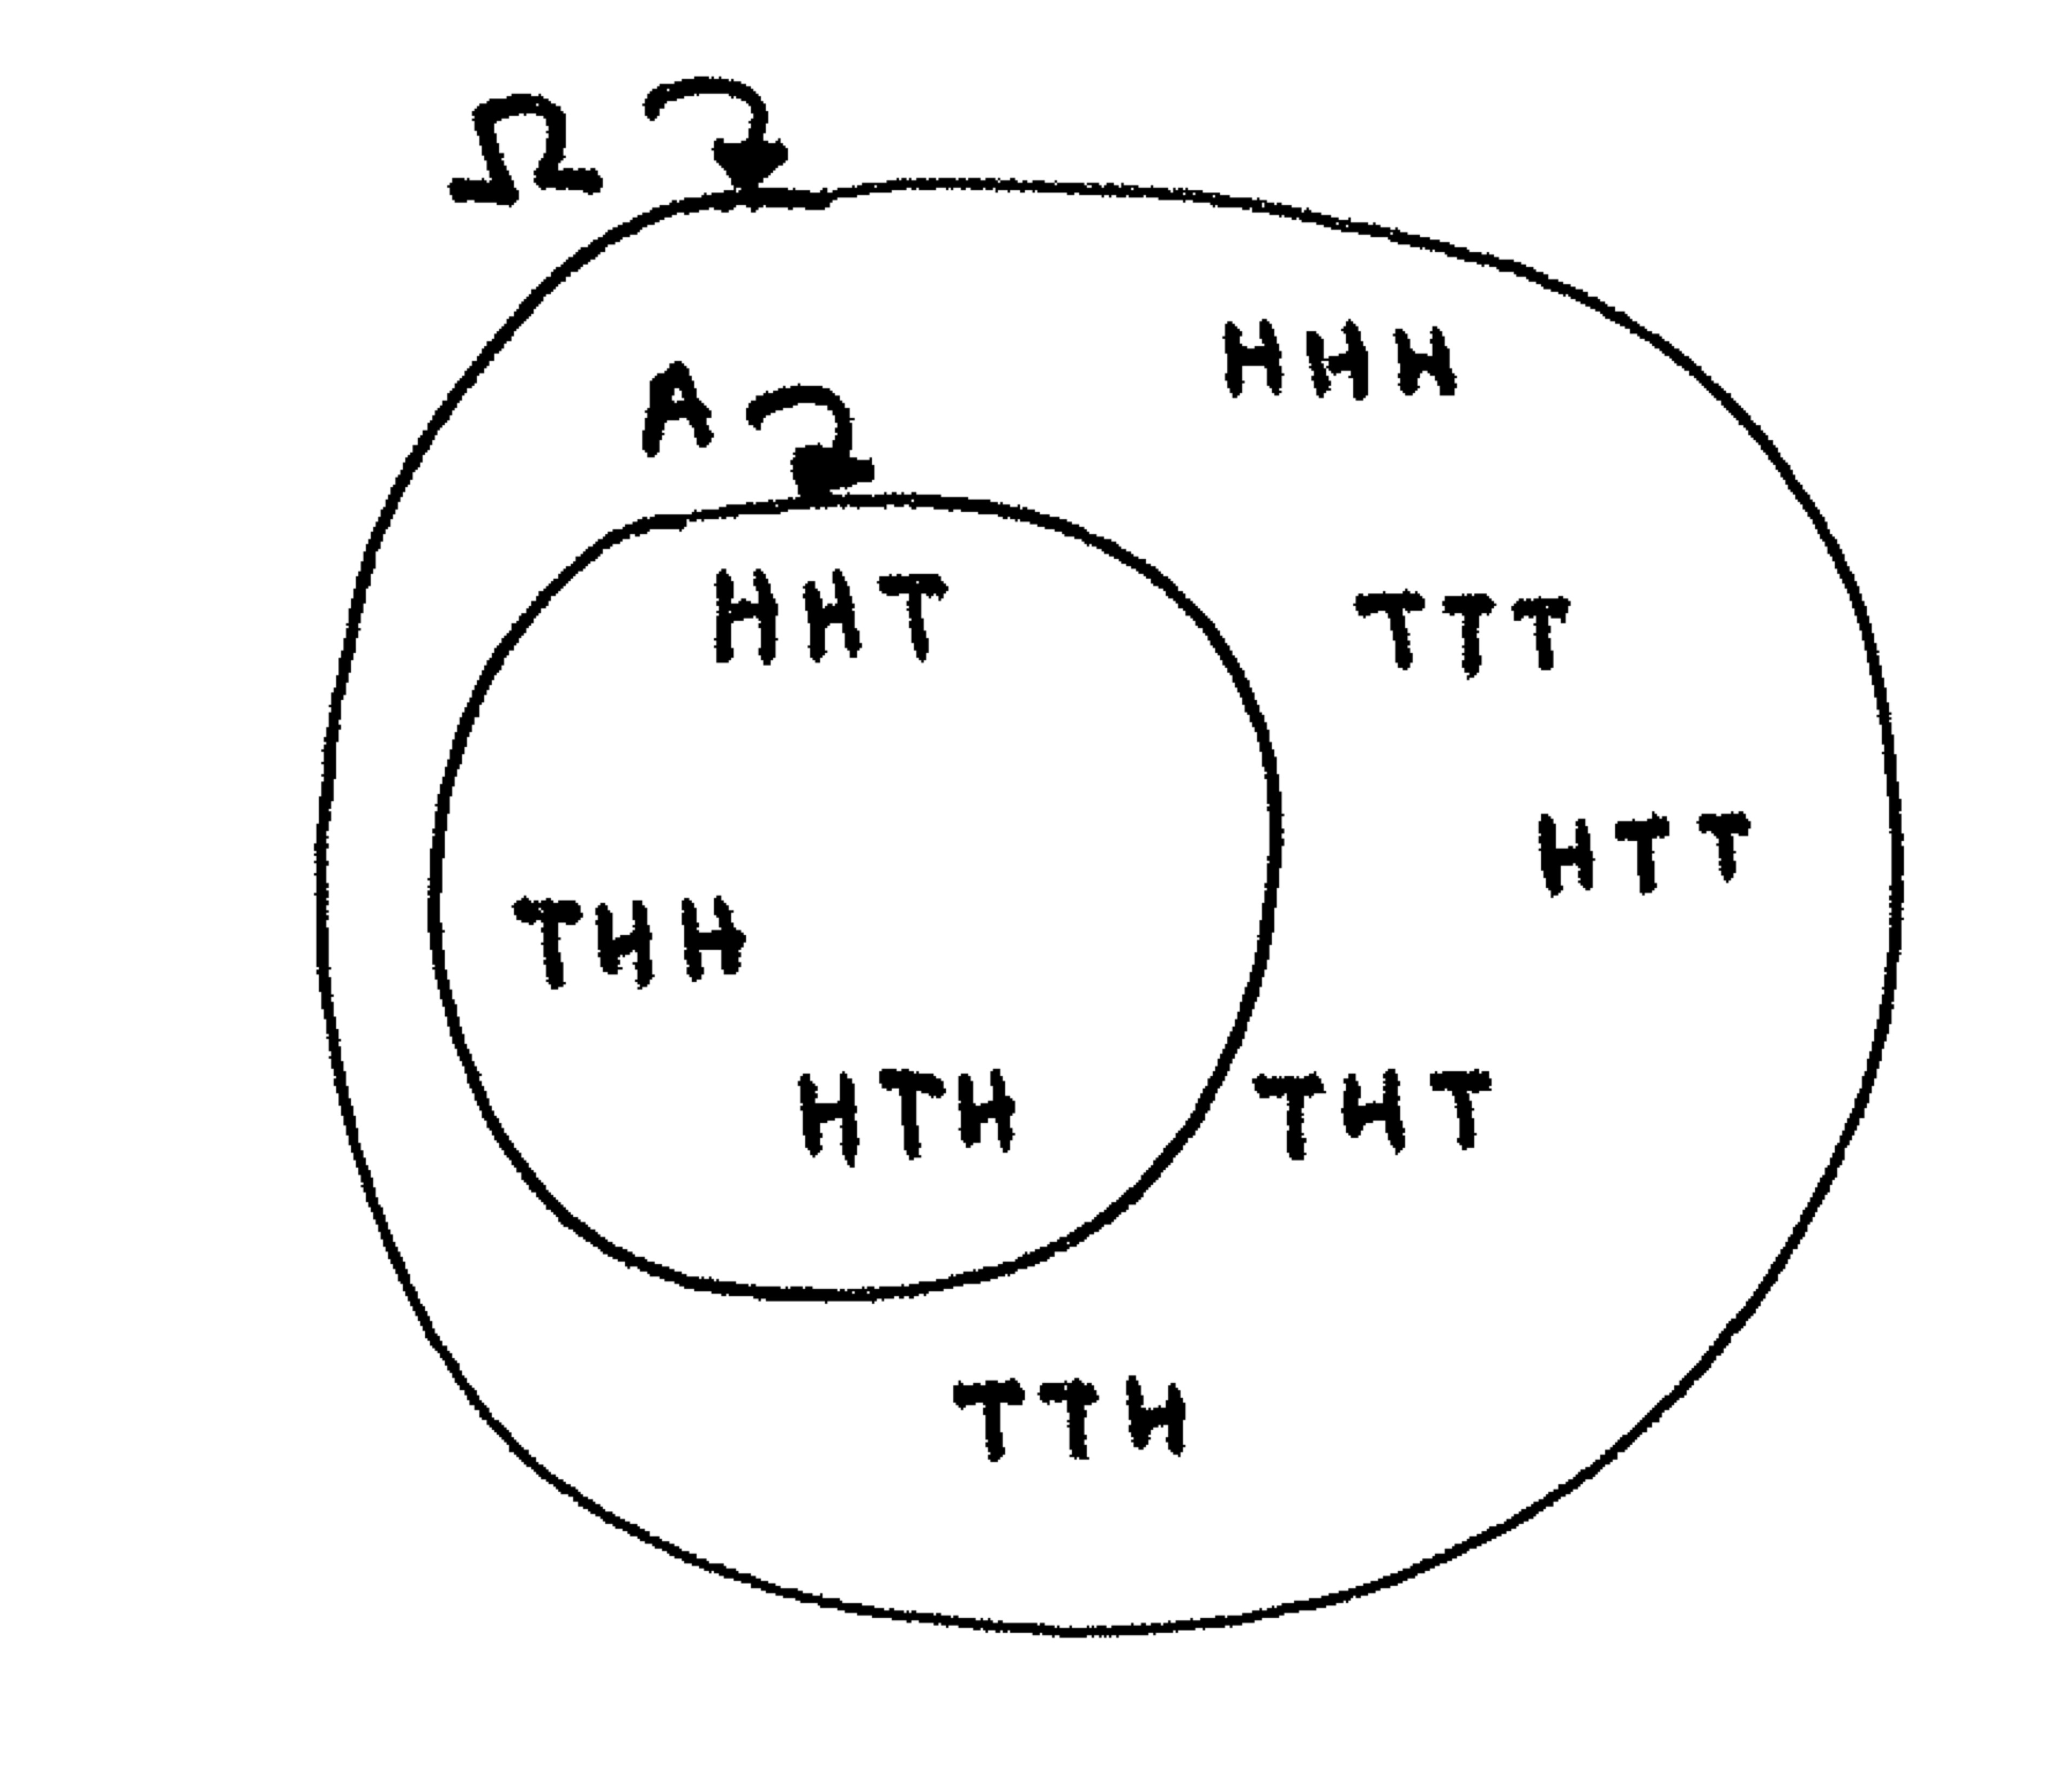
Example
Experiment: "toss a coin three times"
Ω = {HHH, HHT, HTT, HTH, THH, THT, TTT, TTH}
Event A = "exactly two heads" = {HHT, HTH, THH}
Event B = "first one was heads" = {HHT, HTH, HTT, HHH}
Distribution: assign a number between 0 and 1 ("probability") to each basic outcome; sum of all numbers = 1
Uniform distribution: P(x) = 1/8 ∀x ∈Ω
Probability of an event = the sum of the probabilities of its basic outcomes
So, P(A) = ?
P(B) = ?

Slide 4
Joint and Conditional Probability
P(A, B) = P(A∩B) = "joint probability of A and B"
P(A|B) = P(A∩B)/P(B) = "conditional probability of A given B"
P(B|A) = ?

Slide 5
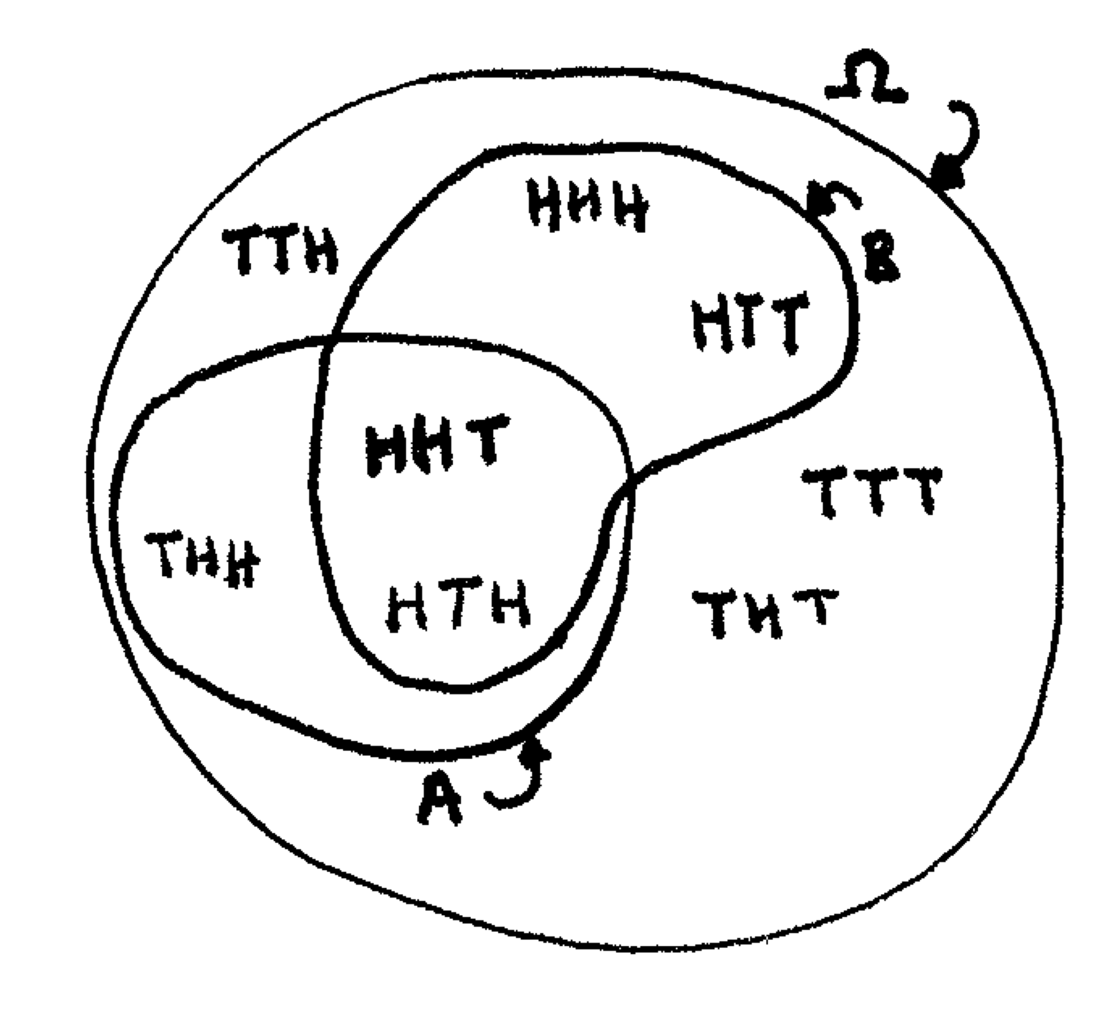
Joint and Conditional Probability
A = "exactly two heads" = {HHT, HTH, THH}
B = "first one was heads" = {HHT, HTH, HTT, HHH}
P(A) = 3/8
P(B) = ½
P(A,B) = P(A) + P(B) ?
No. What is it?
P(B|A) = "if you got 2 heads, what's the chance the first was heads?" = ?
P(A|B) = "if your first was heads, what's the chance you got 2 heads" = ?

Slide 6
Chain Rule of Probability
A₁
A₂
P(A, B) = P(A∩B)
P(A|B) = P(A∩B)/P(B) = P(A, B)/P(B)
Thus, P(A, B) = P(A|B)P(B)
What if we had three events: A₁, A₂, A₃?
Joint probability = P(A₁, A₂, A₃ ) = P(A₁ ∩ A₂ ∩ A₃)
Define " A₂, A₃ " as "B". Then from above, P(A₁, B) = P(A₁|B)P(B)
Now substitute back in: P(A₁| A₂, A₃ )P(A₂, A₃ )
Now rewrite P(A₂, A₃ ) in terms of conditionals: P(A₁| A₂, A₃ ) P(A₂|A₃ )P(A₃)
Notice: P(A₁, A₂, A₃ ) = P(A₃, A₂, A₁ ) = P(A₃| A₂, A₁ ) P(A₂|A₁ )P(A₁)
In general, P(A₁...A_{n}) = P(A₁|A₂...A_{n})P(A₂|A₃...A_{n})...P(A_{n-1}|A_{n})P(A_{n})
A₃

Slide 7
Aside: Ethics
Probability and Statistics have world-beneficial potential
Disease prevention
Economics
Agriculture
Origins?
Pascal and Fermat arguing over games of chance in 1654
Gambling industry exploits disease

Slide 8
Aside: Ethics
AI, NLP also have potential benefit and harm
Reduce miscommunication
Accident prevention
Faster research
Sudden workforce upheaval
Marginalization of some populations
Energy consumption
Spiderman principle: "With great power comes great responsibility"

Slide 9
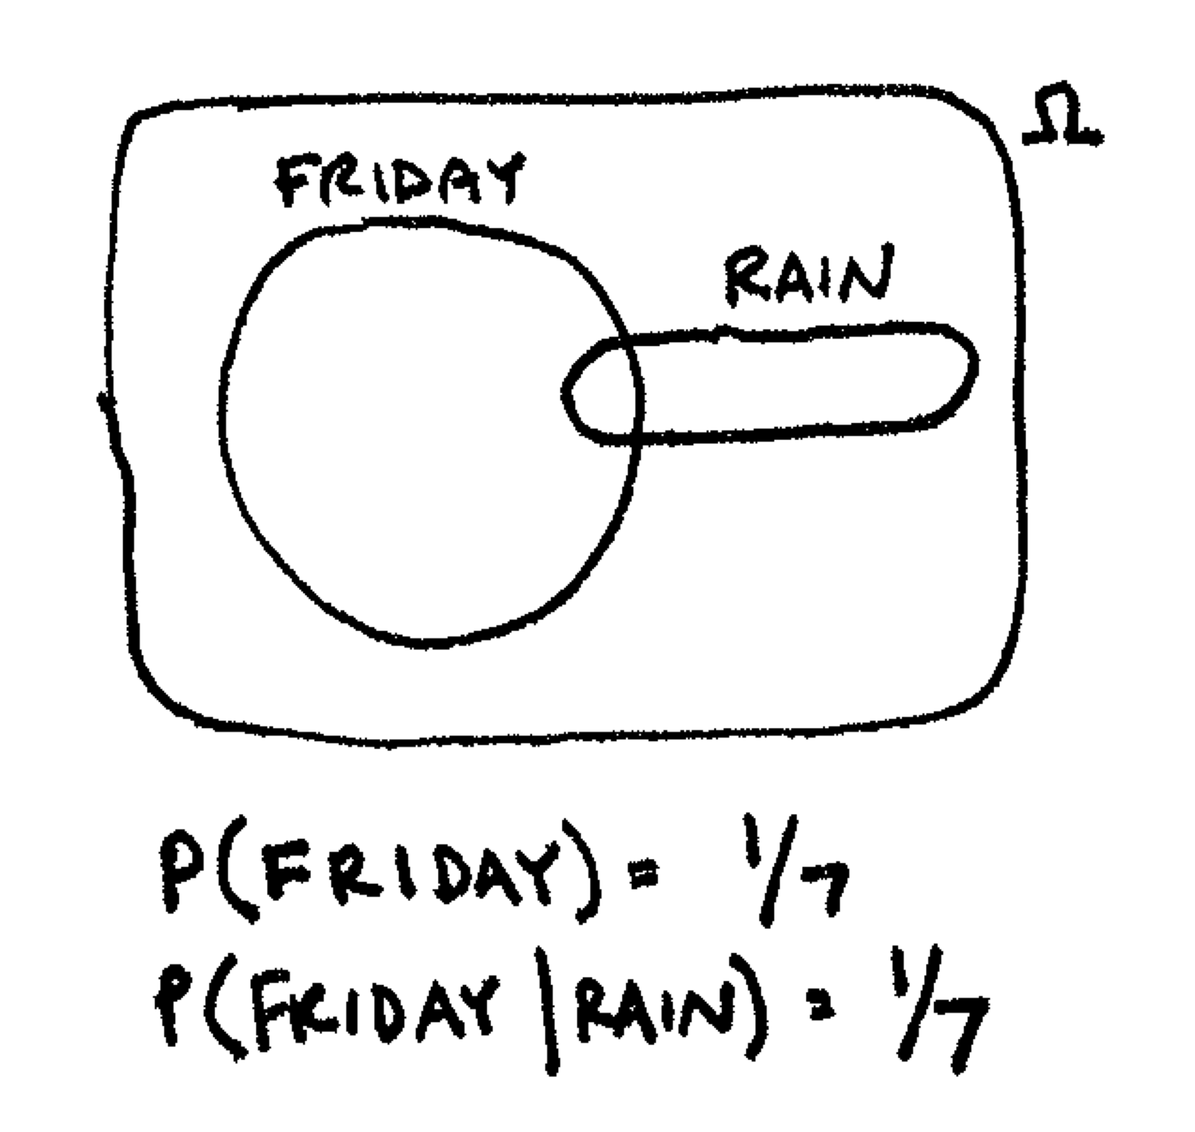
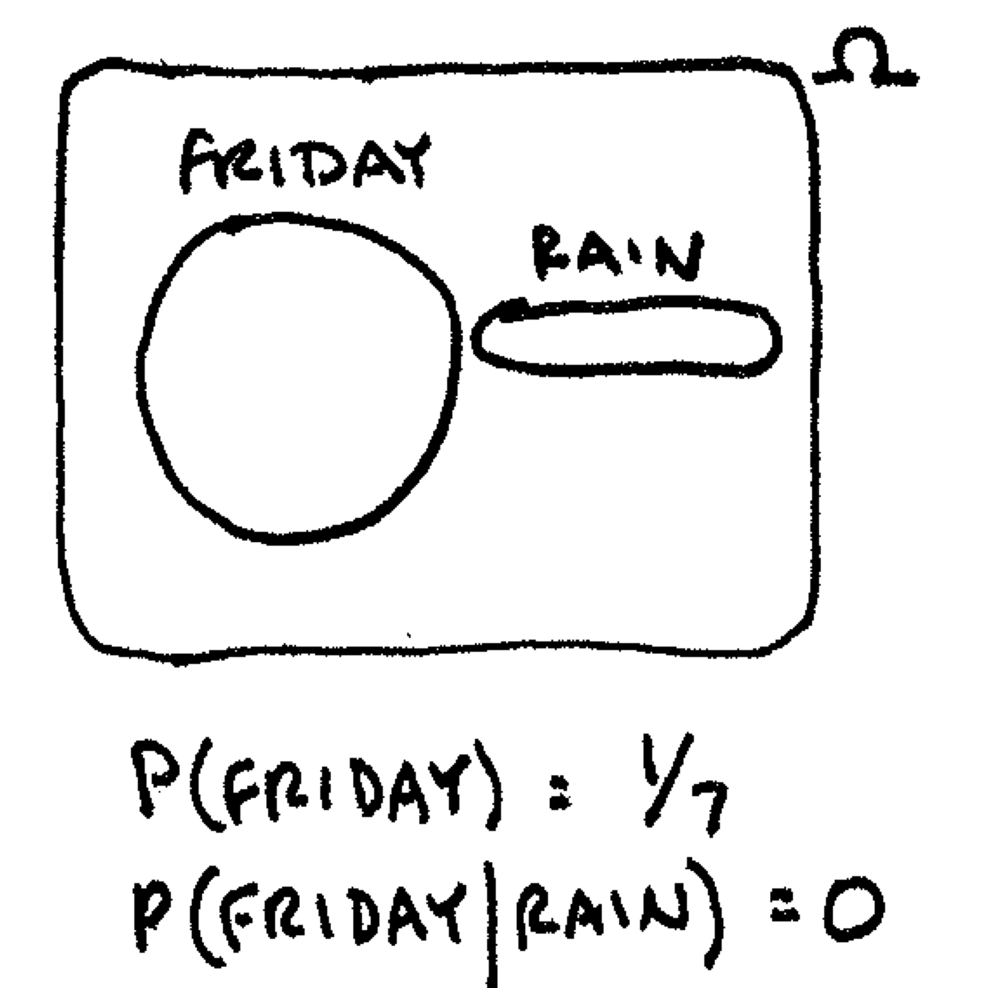
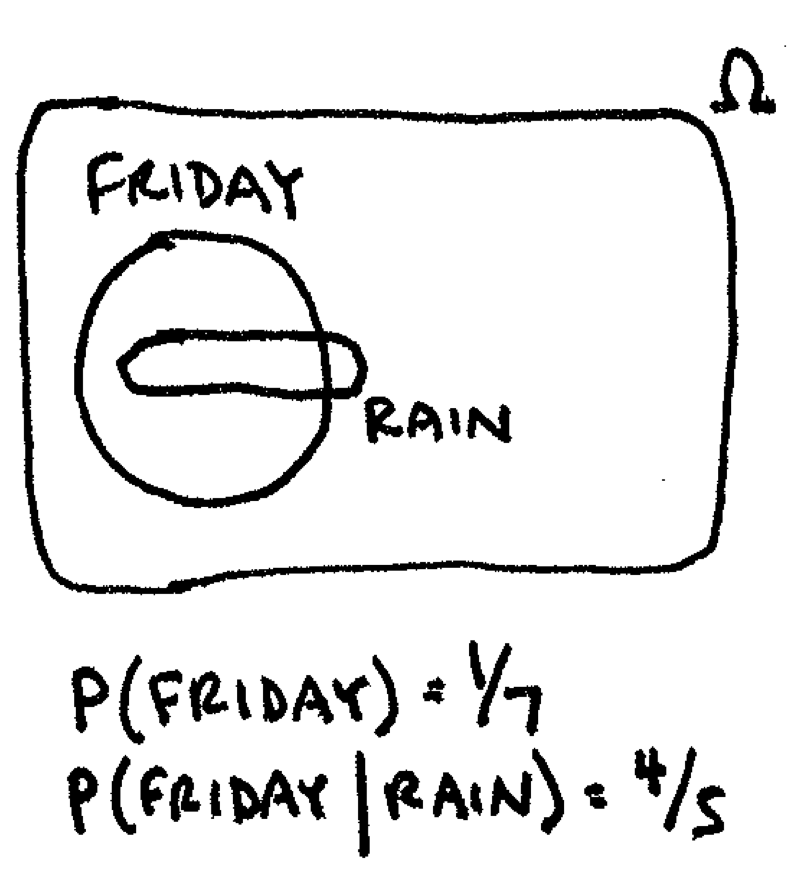

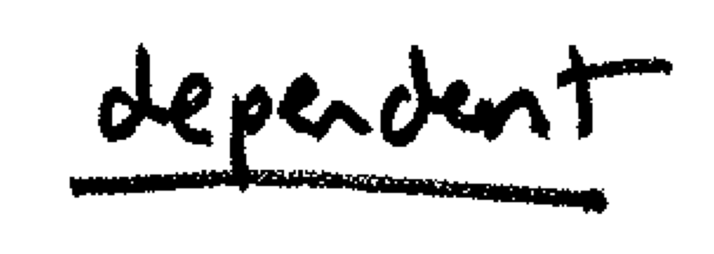
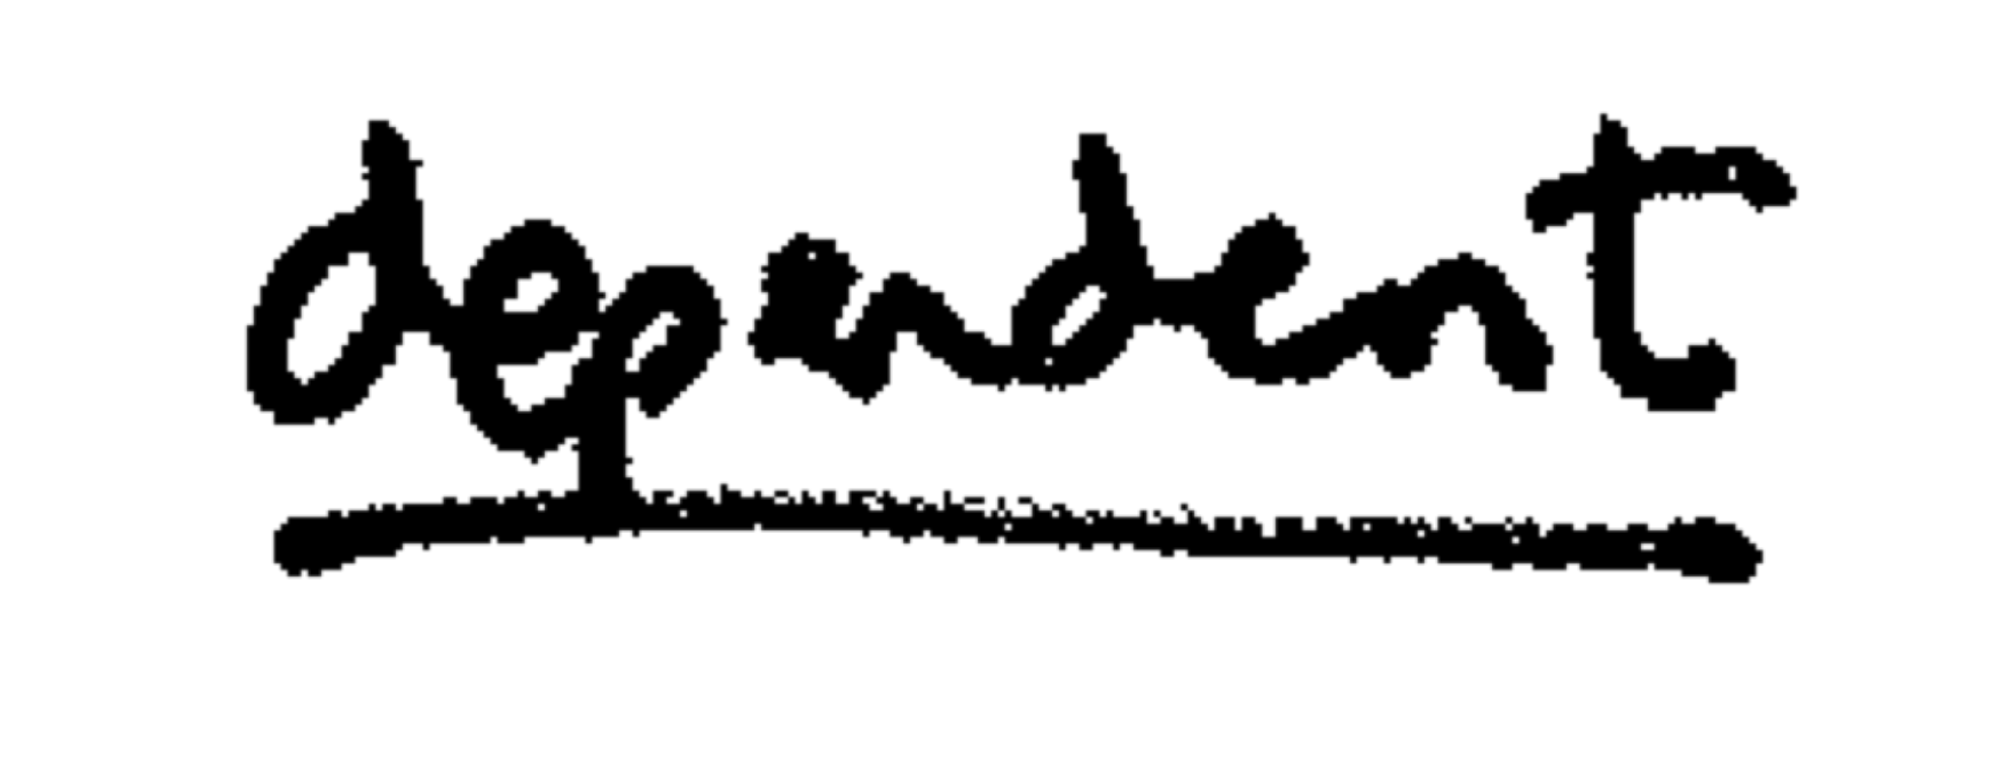
Independence
Events A and B are independent if P(A) = P(A|B)

Slide 10
Bayes' Rule
P(A|B) = P(A, B)/P(B); P(A, B) = P(A|B)P(B)
P(B|A) = P(A, B)/P(A); P(A, B) = P(B|A)P(A)
P(A|B)P(B) = P(B|A)P(A)
P(A|B) = P(B|A)P(A)/P(B)

Slide 11
Law of Total Probability
Let there be events E₁...E_{n} that partition an outcome space (Ω)
∑_{i=1}^{n} P(E_{i}) = 1
0≤P(E_{i})≤1
For any B ⊆Ω
P(B) = ∑_{i=1}^{n} P(B, E_{i})

Slide 12
Using Bayes' Rule and Law of Total Probability
Some people can read minds!
Not very many of them;
P(MR) = 1/100,000
I have invented a mind reader detector test!
If you're a mind reader I can detect this with 95% accuracy : P(T|MR) = 0.95
If you're not, I can detect this with 99.5% accuracy: P(¬T|¬MR) = 0.995
Jill takes the test. The test says "T" (true). How likely is it that Jill is a mind reader?

Slide 13
Jill Passed the Test. Is She a Mind Reader?
P(MR)
MR | .00001
¬MR | .99999
P(MR|T) = ?
P(MR|T) = P(T|MR)P(MR)/P(T)
How do we use P(T|MR) and law of total probability to get P(T)?
P(T) = P(T,MR)+P(T,¬MR)
P(T,MR) = P(T|MR)P(MR) = .95*.00001=.0000095
P(T,¬MR)=P(T|¬MR)P(¬MR) = .005*.99999 = .00499995
P(T) = .00500945
P(MR|T) = .95*.00001/.00500945 ≈ 0.002
P(T|MR) | T | ¬T
MR | .95 | .05
¬MR | .005 | .995

Slide 14
Argmax and Bayes' Rule
argmax_{Ai}P(A_{i}) ≝ "The A_{i} with highest probability"
A_{i} = {rain, snow, sun}
P(rain) = 0.1; P(snow) = 0.1; P(sun) = 0.8;
argmax_{Ai}P(A_{i}) = ?
Consider argmax in the conditional case
argmax_{Ai} P(A_{i}|B)
= argmax_{Ai} P(A_{i})P(B|A_{i})/P(B)
= argmax_{Ai} P(A_{i})P(B|A_{i})
why?
sun

Slide 15
Argmax and Bayes' Rule
argmax_{Ai} P(A_{i})P(B|A_{i}) may be easier to work with than argmax_{Ai} P(A_{i}|B)
Let B be a misspelled character sequence ("limf")
Let A₁...A_{n} be possible corrections ("lime", "limb", "limn")
P(A_{i}|B) = ?
P(A_{i}) * P(B|A_{i})
Can bring more knowledge to help!
keyboard distance?
word likelihood
"We must surgically amputate the limf"

Slide 16



Bayes' Rule and Noisy Channel Model
By reformulating in this way we're taking a particular view of how we view events
P(A_{i})
P(B|A_{i})
A_{i}
B
"fat fingers"
"limb"
"limf"
"language producer"
decode

Slide 17
Quiz Questions
Experiment: I have two bowls, each with 100 balls numbered 1 through 100. I pick 1 ball at random from each bowl
1) What is the size of the sample space (Ω)?
A) 200
B) 100
C) 10,000
D) infinite
2) What is the set of outcomes for the event "the sum of the balls is 200"?
A) {(200)}
B) {(100, 100)}
C) ∅
D) {(4, 50), (50, 4), (10, 20), (20, 10)}
What is the probability of the event in Q2 (assume uniform distribution)?

Slide 18
Quiz Questions
3) Which of these are possible probability distributions (multiple or no selections allowed)?
A) (1.3, 2)
B) (0.2, 0.2, 0.2, 0.2)
C) (0.2, 0.2, 0.2, 0.2, -0.1, 0.3)
D) (0.2, 0.2, 0.2, 0.2, 0.2)
E) (0, 1, 0)
F) (1)
G) (1/8, ¼, 5/8)
H) (-0.5, -0.5)

Slide 19
Estimating Probabilities
How do we get these basic outcome probabilities?
Do experiments!
Find some data (a sample)
Count stuff in the sample
e.g. "how often do sentences start with the word 'So'?
Experiment: Observe sentences that occur in the world
Basic outcomes: {every possible sentence that could occur}
Event A: {sentences that start with 'So'}
P(A) = count of sentences starting with 'So' in the sample/sentences in the sample
P(A|B) = count(A, B)/count(B)

Slide 20
Data and Model
Suppose we have a biased 12-sided die and we throw it repeatedly:
result | count
1 | 0
2 | 7
3 | 26
4 | 45
5 | 119
6 | 70
result | count
7 | 31
8 | 14
9 | 6
10 | 0
11 | 4
12 | 2
It's easy to estimate the 11 free parameters (why 11?)
Total rolls = 324; P(1) = 0/324 = 0; P(5) = 119/324 = .367
P(12) = 1-(P(1)+P(2)+...+P(11))

Slide 21
Data and Model
?
?
What if you only saw the results and weren't told how they were generated?
Another theory: sum of two 6-sided die rolls
What about sum of three 4-sided dice?
In the 2d6 case, P(8) = P(3)P(5) + P(4)P(4) + P(5)P(3)
Now only 5 free parameters
result | count
1 | 0
2 | 7
3 | 26
4 | 45
5 | 119
6 | 70
result | count
7 | 31
8 | 14
9 | 6
10 | 0
11 | 4
12 | 2

Slide 22
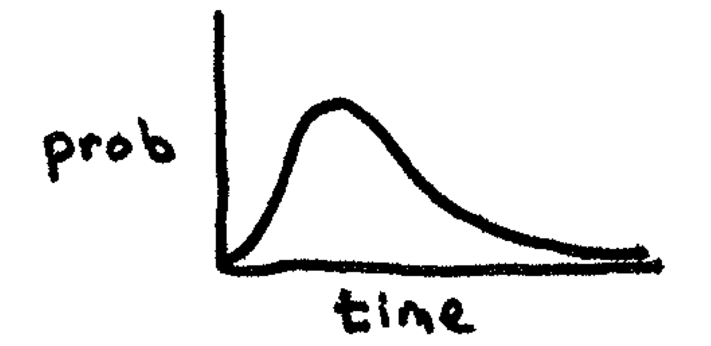
Data and Model
Maybe it's not dice at all
Could be number of minutes of phone calls
Historical data shows this follows a gamma curve
Shape is fixed but two numbers control center and 'flatness'
result | count
1 | 0
2 | 7
3 | 26
4 | 45
5 | 119
6 | 70
result | count
7 | 31
8 | 14
9 | 6
10 | 0
11 | 4
12 | 2

Slide 23
Data and Model
General theory of how data got generated, together with a set of parameter estimates is called a model
Questions:
Given a theory T, how do we know if one set of parameter estimates is better than another?
Which is better: theory T with parameters t or theory S with parameters s?
i.e. is one theory in general better than another?
can we automatically identify the best model (best theory+param combination)?
?
result | count
1 | 0
2 | 7
3 | 26
4 | 45
5 | 119
6 | 70
result | count
7 | 31
8 | 14
9 | 6
10 | 0
11 | 4
12 | 2
BIG MACHINE LEARNING QUESTIONS!

Slide 24
Data and Model
Ask the data!
For data D and models m in M, find argmax_{m} P(m|D)
By Bayes' rule this is equal to argmax_{m} P(m) P(D|m)
If we don't have any prior preferences, i.e. distribution over M is uniform, then it's just argmax_{m} P(D|m)
does this model look
generally good?
given the model,
does the data look reasonable?

Slide 25
Determining P(D|m)
SAMPLE
Quantitative!
Get some D (a sample)
apply each m
P(D|m) = ∏_{d∈D}P(d|m)
m1: ½ * ½ * ½ * ½ = .0625
m2: ¾ * ¾ * ¼ * ¾ = .105
m3: 9/10 * 9/10 * 1/10 * 9/10 = .073
argmax_{m}P(D|m) = m2
This is the maximum likelihood estimation (MLE)
Model | P(H) | P(T)
m1 | .5 | .5
m2 | .75 | .25
m3 | .9 | .1
m2!

Slide 26
What if we have an opinion about M?
M | P(M)
m1 | .9
m2 | .1
m3 | .1
e.g. the coin doesn't look biased
We could also compare the d12 vs 2d6 theories using the same technique!

Slide 27
Quiz Questions
P(A) = ½; P(A ∩ B) = ¼; P(B) = 3/10
4) What is P(A|B) ?
A) 5/6
B) 1
C) ¼
D) ½
5) What is P(B|A)? (same choices)
6) What is P(A, B)? (same choices)

Slide 28
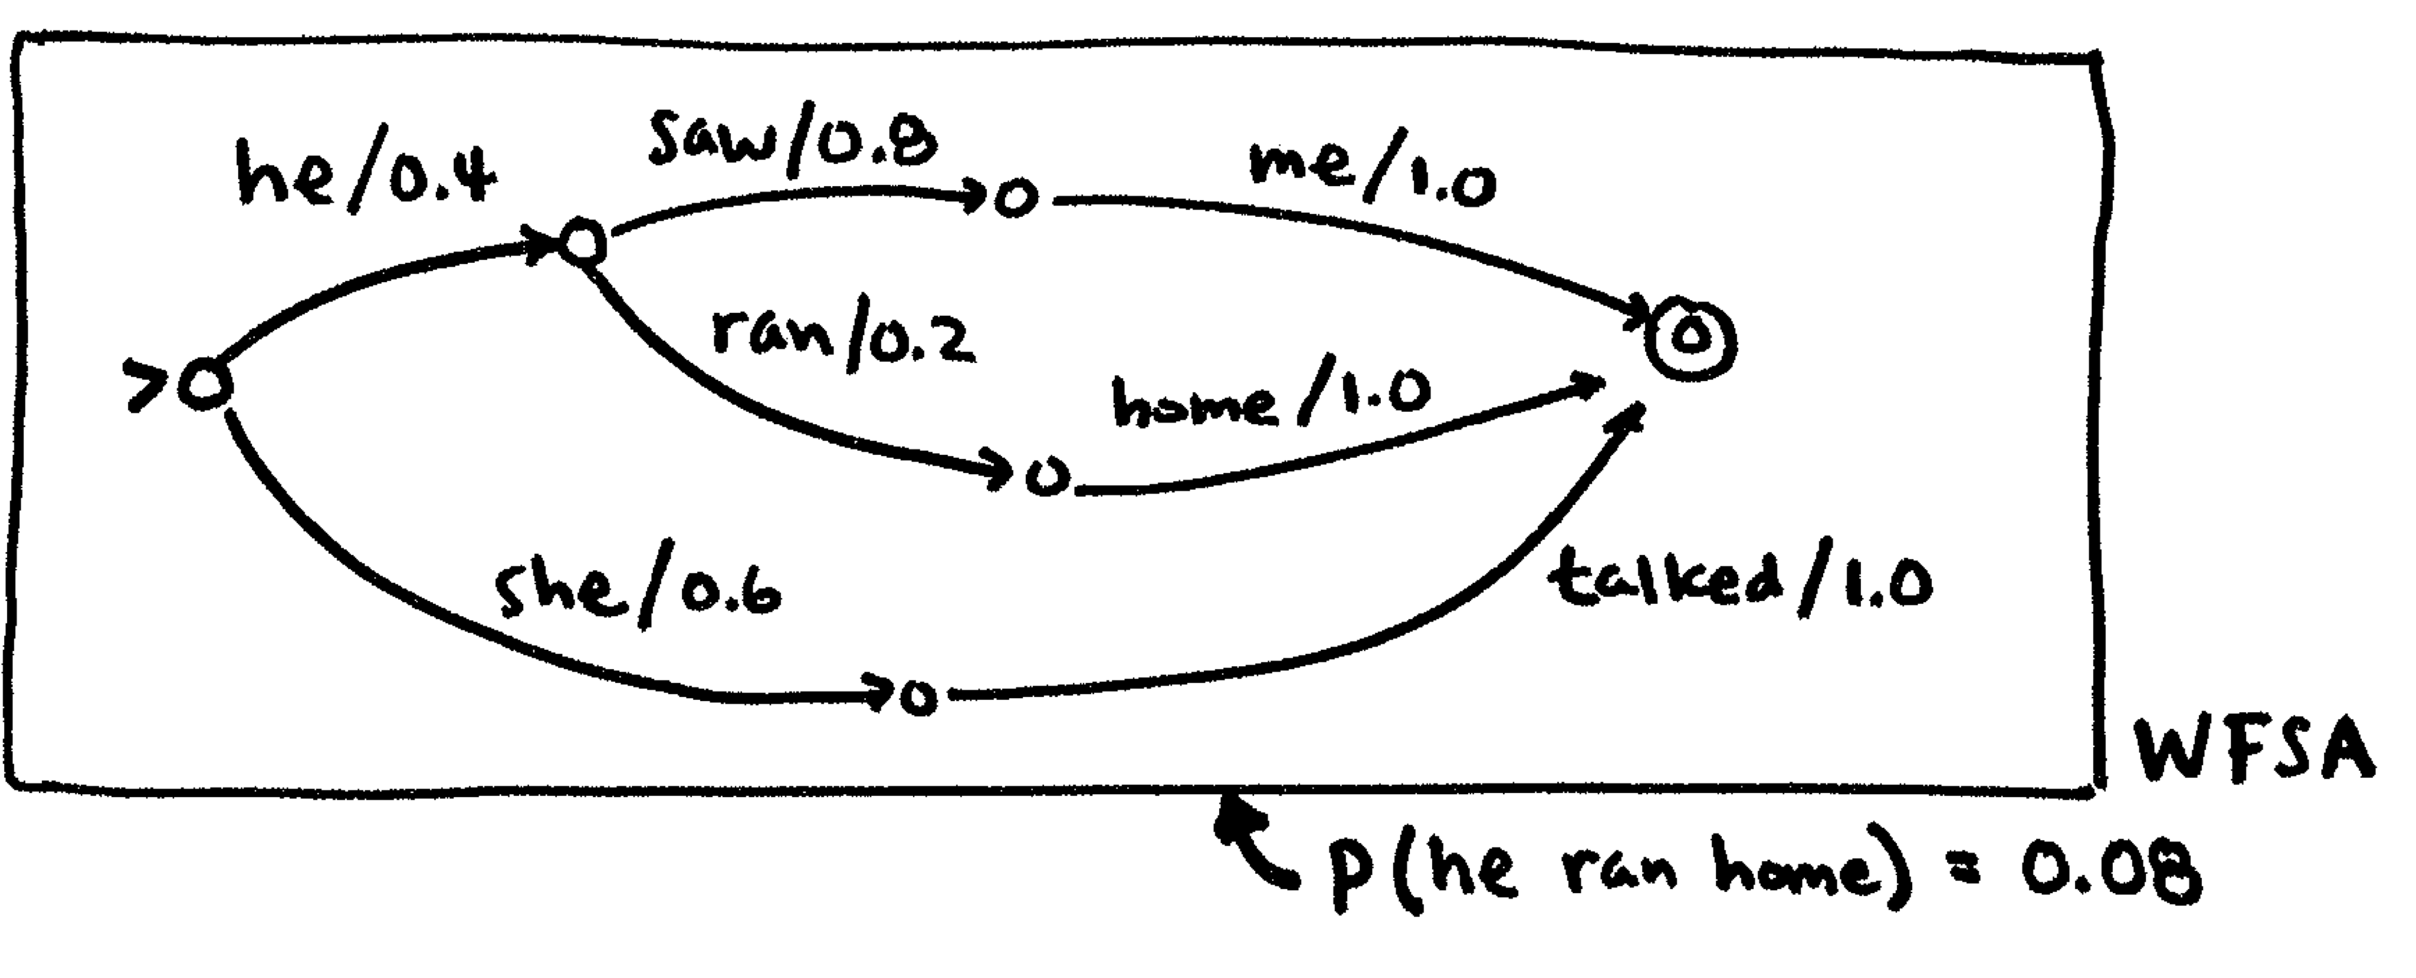
Adding Probabilities to FSA
Aside from a label, FSAs can have a weight; then they're weighted finite-state automata (wFSA)
If the weights of arcs leaving a path sum to 1 (final state excluded) it's probabilistic (pFSA)
Weight of a path = product of the weights of the arcs

Slide 29
pFSA is a way to encode P(A)
"she talked" = .6
"he saw me" = .32
"he ran home" = .08

Slide 30
wFSA is just a weighted graph
We can use best-path algorithms (Dijkstra) to efficiently find the most probable path (after converting to log space)
We can use FSA intersection to efficiently look up the probability of a sentence

Slide 31
Adding Probabilities to FST
FSTs can also have weighted arcs
If the weights of all outgoing arcs from a state with the same input symbol sum to 1, it's a pFST
FST transduces string x into string y
pFST transduces x into y with probability P(y|x)
Note: probabilities no longer reversable!

